Slide 1



Session 8
Client-side Development Using ASP.NET Core MVC
For Aptech Centre Use Only

Slide 2
Session Overview
Define static files in ASP.NET
Define ADO.NET Core MVC
Describe client-side validation
Describe server-side validation
Explain how to implement a Core MVC application
For Aptech Centre Use Only

Slide 3
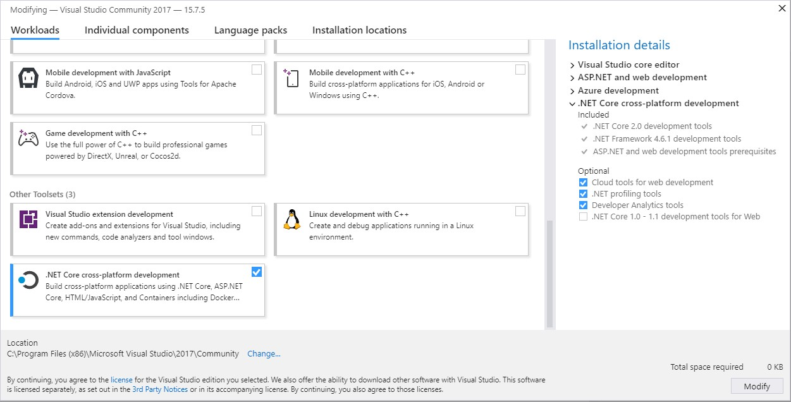
Overview of ASP.NET Core (1-2)
ASP.NET Core is a part of Visual Studio optional installation
It is not installed by default
For Aptech Centre Use Only
.NET Core Installation

Slide 4
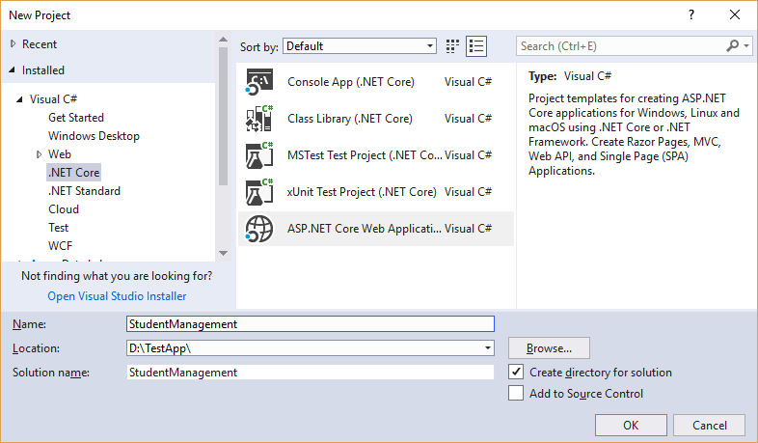
Overview of ASP.NET Core (2-2)
For Aptech Centre Use Only
.NET Core Project

Slide 5
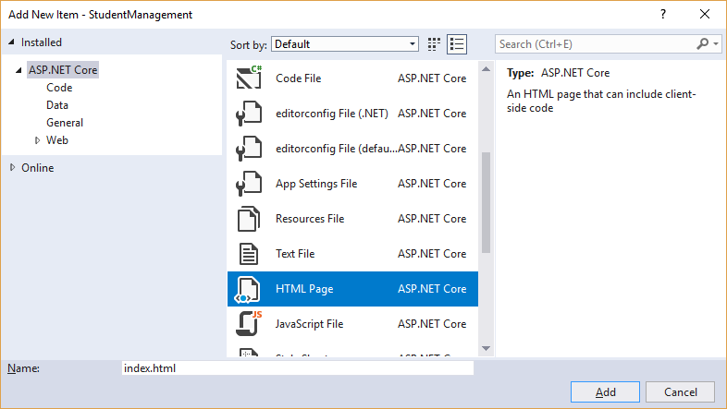
Static Files in ASP.NET (1-2)
ASP.NET Core applications can serve static files, such as HTML, JavaScript, images, and Cascading Style Sheet (CSS) files.
Web root (wwwroot) folder stores these static files.
For Aptech Centre Use Only
Adding HTML File to the Application

Slide 6
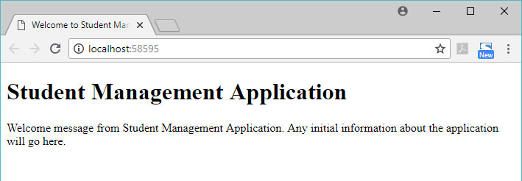
Static Files in ASP.NET (2-2)
For Aptech Centre Use Only
Index.Html File Loaded

Slide 7
Introduction to ASP.NET Core MVC (1-2)
Lightweight
Open source
Highly testable presentation framework
Provides a patterns-based way to build dynamic Websites
Enables clean separation of concerns and full control over markup
Supports Test Driven Development (TDD)-friendly development
Uses latest Web standards
For Aptech Centre Use Only

Slide 8








Introduction to ASP.NET Core MVC (2-2)
Strongly Typed Views
Razor View Engine
View Components
Web APIs
For Aptech Centre Use Only
Model Binding
Model Validation
Dependency Injection
Routing

Slide 9
Differences between ASP.NET Core MVC and ASP.NET MVC 5
 | ASP.NET Core MVC | ASP.NET MVC 5
 | A new approach to server-side and client-side dependency management of packages. | Reference to assemblies, library, framework, or any third-party packages is added using NuGet package manager.
 | Apps do not use Internet Information Services (IIS) for hosting. | Apps use IIS for hosting.
 | Single aligned Web stack for ASP.NET Core MVC and Web APIs. | Provides an option to choose between MVC or Web API, or both, because Web stack for MVC 5 and Web API are different.
 | Inbuilt Dependency Injection (DI) support for ASP.NET Core. | Separate DI containers such as Unity, AutoFac, StructureMap, and so on.
For Aptech Centre Use Only

Slide 10


Client-side Validation (1-3)
Form Data
For Aptech Centre Use Only
Client Side Validation
Server Side Validation

Slide 11
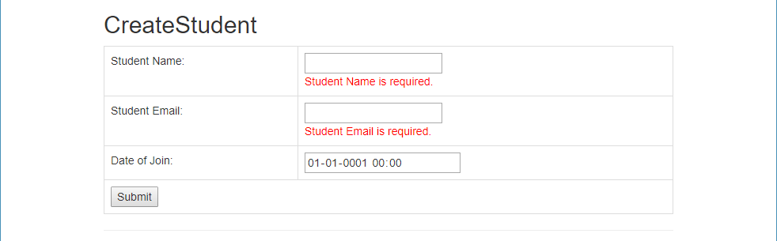
Client-side Validation (2-3)
For Aptech Centre Use Only
Client-side Validation Using JavaScript

Slide 12
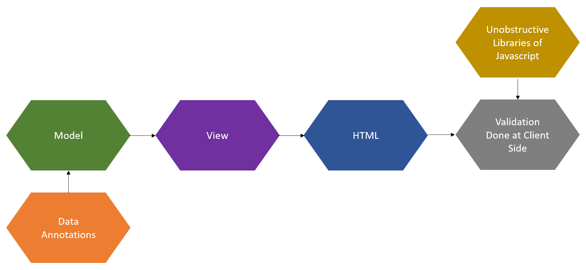
Client-side Validation (3-3)
For Aptech Centre Use Only
Client-side Validation

Slide 13
Server-side Validation (1-4)
Update the view method. Display validation error message using span tag helper with asp- validation-for attribute.
Verify ModelState by updating controller action method. Add date to database if ModelState is valid. Else, update ViewModel and render view method again with validation error message.
Add data annotation attributes to ViewModel model class.
For Aptech Centre Use Only

Slide 14
Server-side Validation (2-4)
Range:
The minimum and maximum constraints are defined.
MinLength:
The minimum length that a property must have for the validation to succeed is defined.
MaxLength: The maximum length of the property is defined. The validation fails if the length of the property value exceeds.
Required:
An indication that the property is required.
RegularExpression
: A regular expression
For Aptech Centre Use Only
for data validation is used by using this attribute.

Slide 15
Server-side Validation (3-4)
Updates the ModelState based on the data annotation attribute in the View model
Saves the entered data to the database when the ModelState is valid
Renders View model again with validation error message when the ModelState is not valid
Verifies the ModelState in the controller's action method
Enters the invalid data
For Aptech Centre Use Only

Slide 16
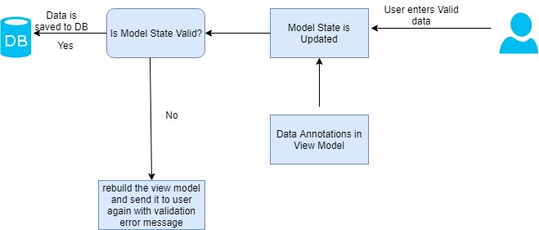
Server-side Validation (4-4)
For Aptech Centre Use Only
Server-side Validation

Slide 17
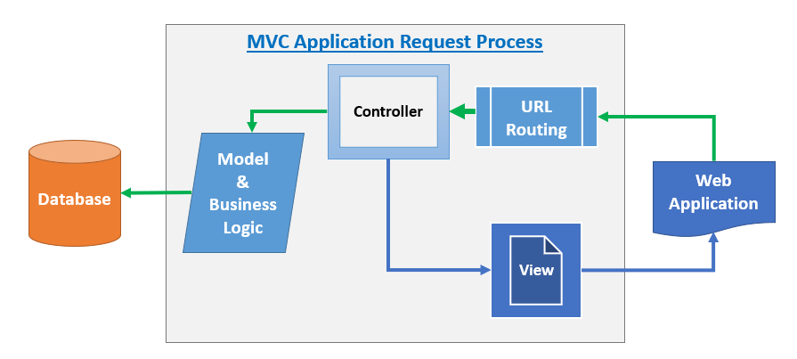
Implementing a Core MVC Application (1-2)
For Aptech Centre Use Only
Core MVC Web Application

Slide 18
Implementing a Core MVC Application (2-2)
1. Create a database
2. Add a new ASP.NET Core MVC project
3. Set up the data access by adding models
For Aptech Centre Use Only
4. Configure
Web.Config
5. Create the signup page by adding View models, UserManager class, controllers, and
views
6. Run the Application

Slide 19
Summary
ASP.NET Core uses ASP.NET Core MVC framework. It is lightweight, open source, and a highly testable presentation framework.
In server-side validation, the server validates the input submitted by the user. Post validation, a dynamically generated new Web page sends the feedback back to the client.
In client-side validation, all user inputs are validated in the user's browser itself.
Data annotation attributes define the validation rules for properties of
model/ViewModel.
Commonly used data annotation attributes are Required, Range, MinLength, MaxLength, and RegularExpression.
For Aptech Centre Use Only

